Slide 1

Student Result Management System

Slide 2
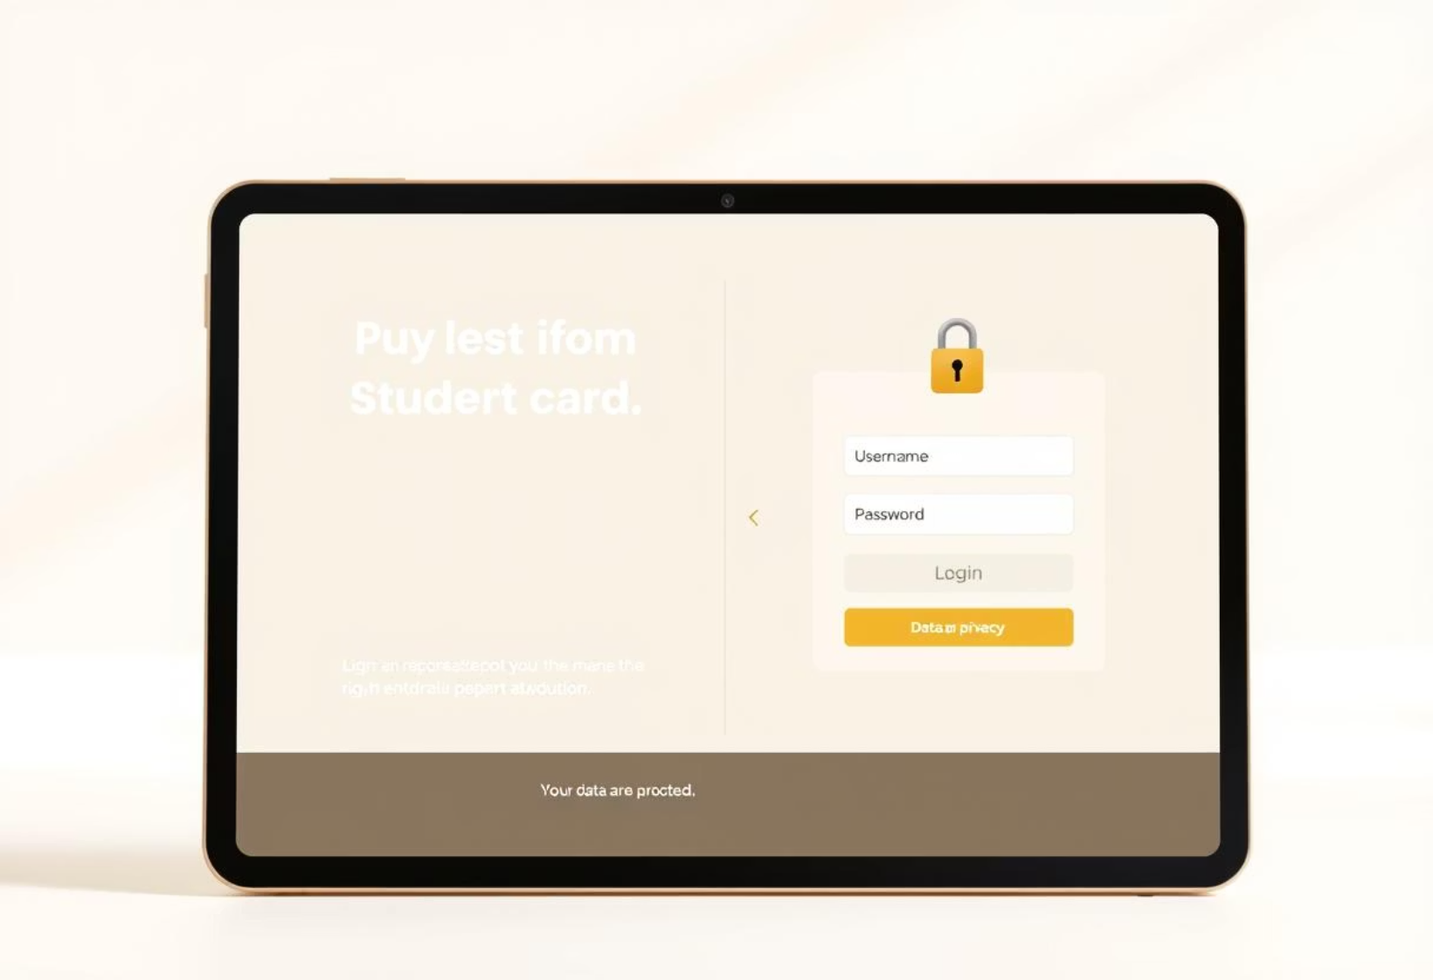
Abstract
The Student Result Management System is a web-based application that helps students view their academic results online. It reduces manual work and errors by digitalizing result entry and management. Students can log in to check subject-wise marks and request revaluation. Staff can update results and manage revaluation requests securely. Built using PHP, MySQL, HTML, and CSS, the system is simple, fast, and user-friendly.

Slide 3


Introduction
The Student Result Management System is a web-based tool designed to manage and publish student results digitally. It allows students to view their subject-wise marks and request revaluation online. Staff can securely update marks and manage result records with ease. This system reduces manual work, avoids errors, and improves result accessibility. Developed using PHP, MySQL, HTML, and CSS, it offers a simple, secure, and user-friendly experience.

Slide 4

Overview of the Student Result Management System
➡️Problem Definition
Manual result management is slow, error-prone, and lacks easy access for students.There is a need for a secure, fast, and online result system.
➡️Existing System
Results are managed on paper or Excel, causing delays and errors.Students can’t view results or revaluation status online.
➡️Proposed System
A web-based system allows students and staff to manage results digitally.It offers secure login, fast access, and reduces manual work.

Slide 5

Implementation and methodology
The system is developed using HTML, CSS, and JavaScript for a responsive and interactive front-end interface.PHP handles server-side logic, while MySQL manages secure storage of student results and revaluation data.Together, these technologies enable a smooth, user-friendly experience for both students and staff.
Front-End Development
HTML5/CSS3 – for structuring and styling the web pages.
JavaScript – for dynamic functionality (e.g., countdown timer, form validation).
Responsive Design – to support desktops, tablets, and smartphones.
Back-End Development
· PHP is used as the server-side scripting language.
· MySQL is used for the relational database management.

Slide 6










Technology Stack
MySQL
PHP
Robust database for data storage.
Backend operations and logic processing.
HTML
Structuring web page content.
JavaScript
Dynamic and interactive elements.
CSS
Styling and responsive design.

Slide 7
Modules of the System
The system is divided into the following key modules:
· Student Module
· Staff/Admin Module
· Result Management Module
· Revaluation Module
· Authentication Module
· Front-End Interface Module

Slide 8

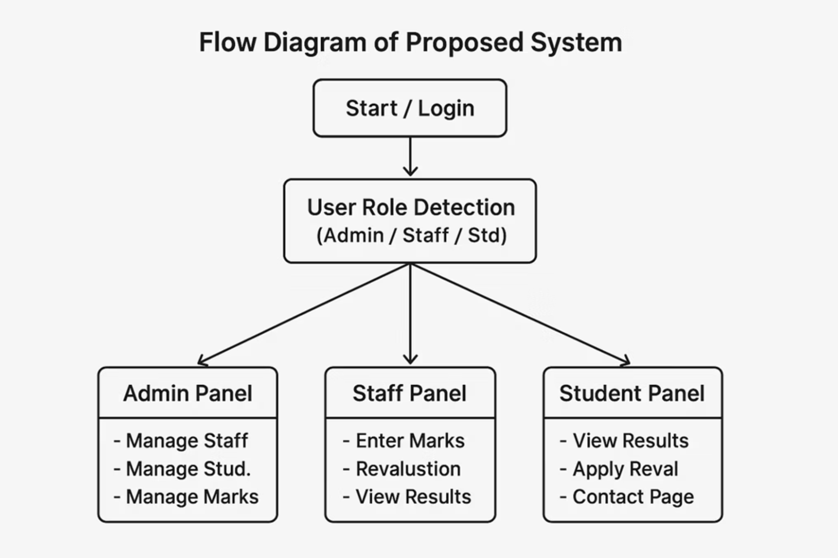
UML Diagrams / Flow Diagram of Proposed System:

Slide 9
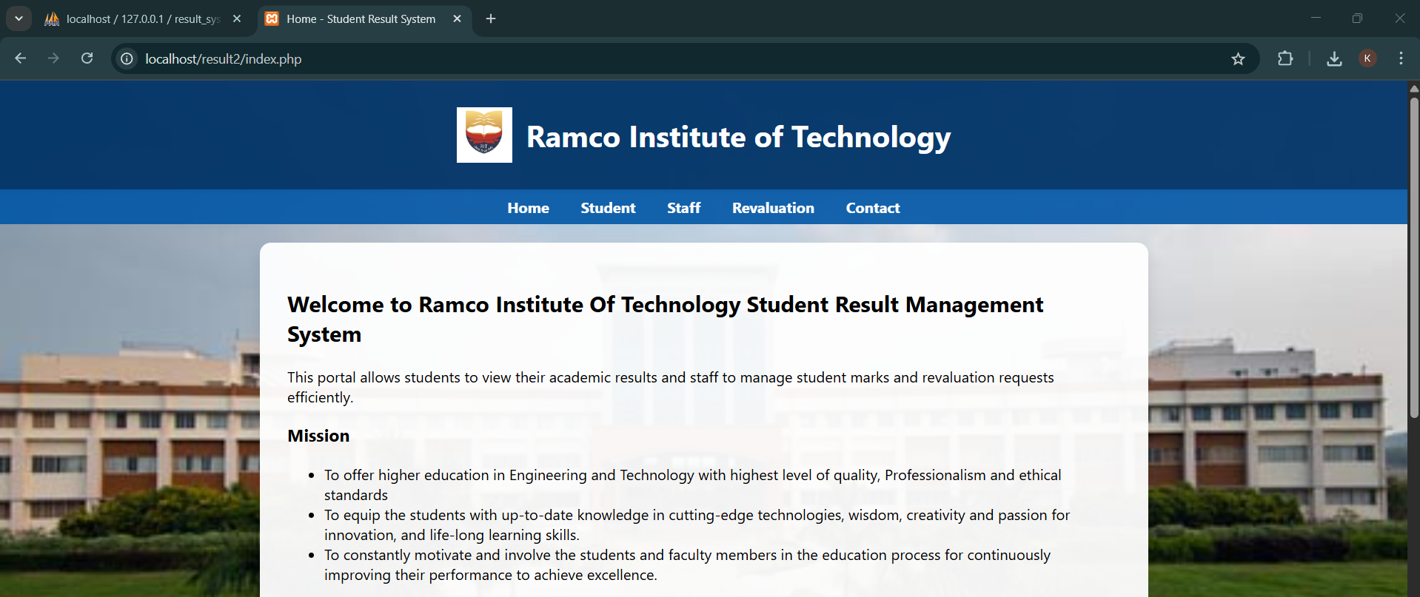
OUTPUT:
Home page

Slide 10
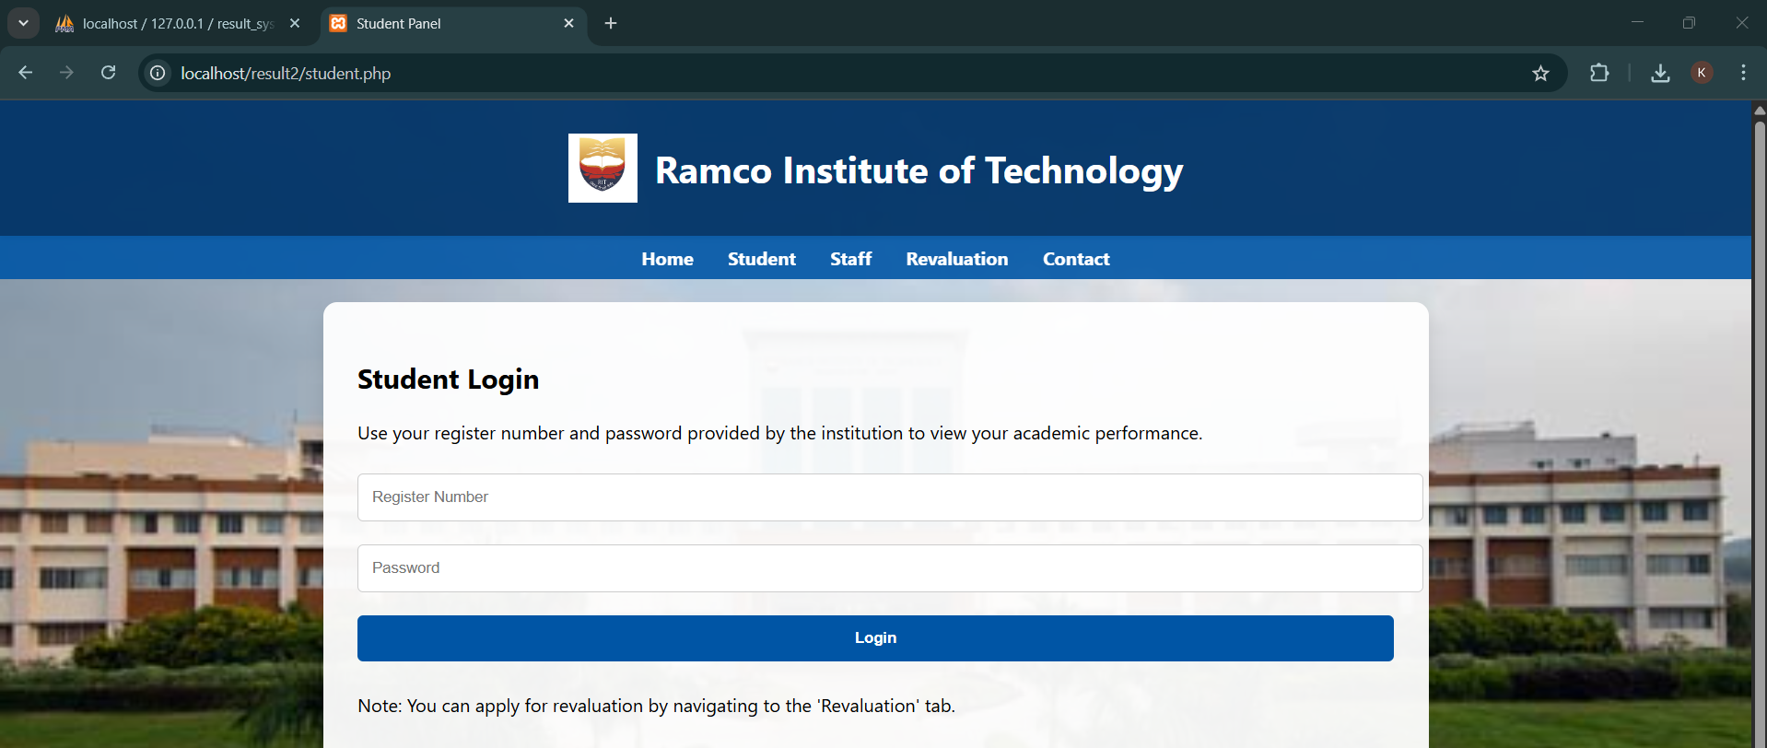
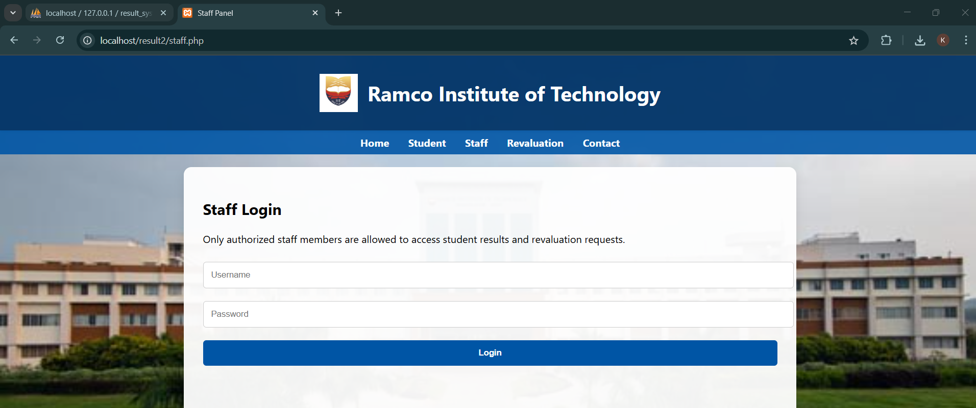
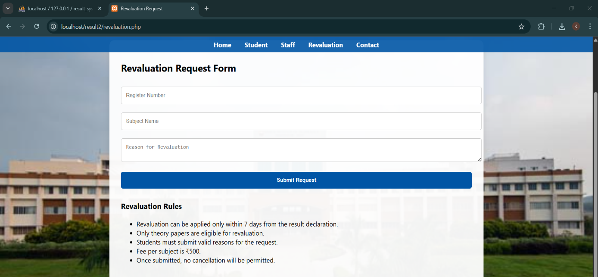
Student Login
Staff login
Revalution Request Form

Slide 11
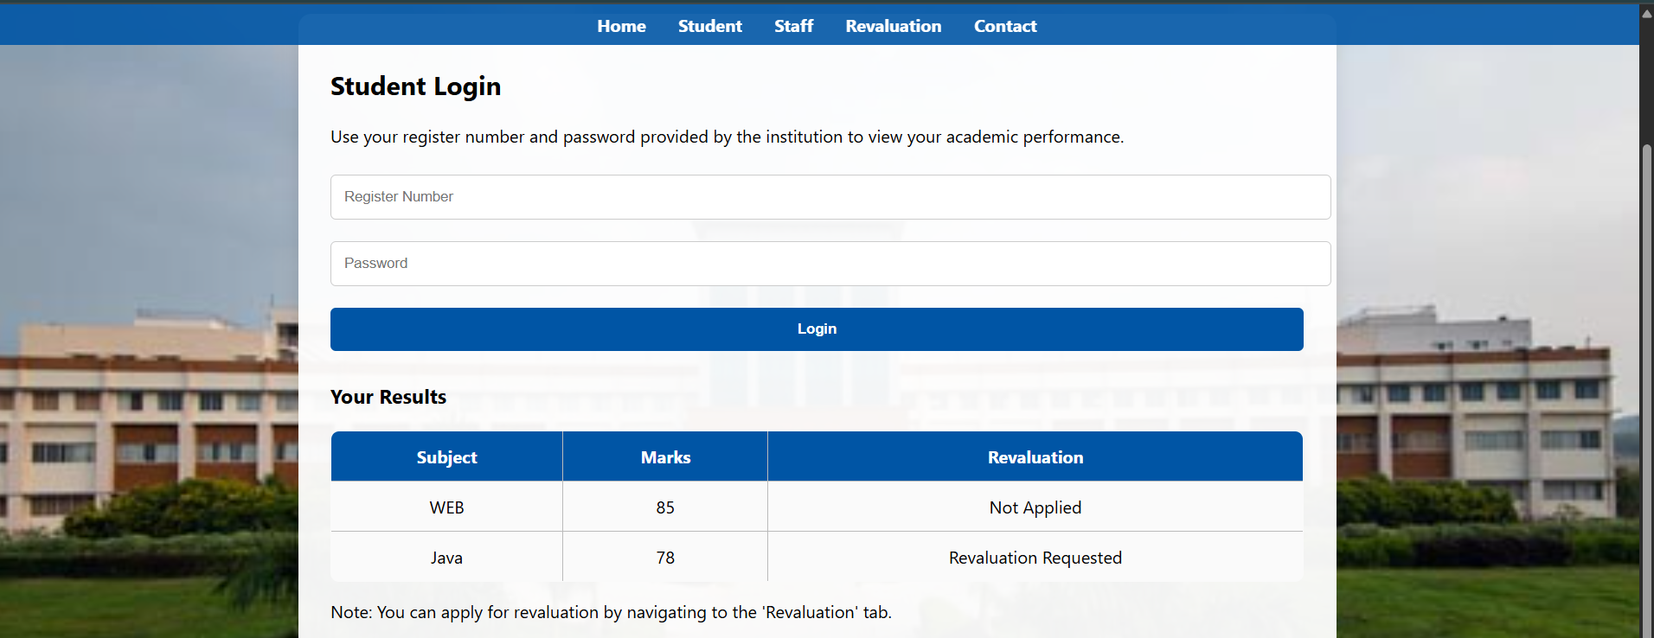
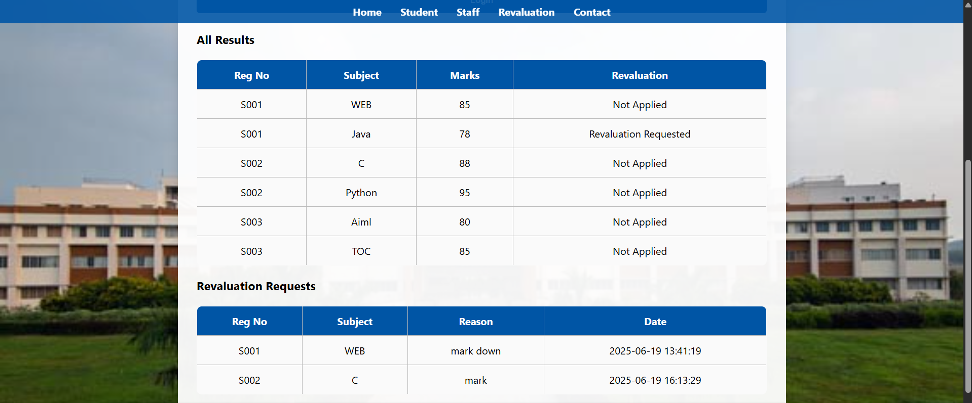
View Result
View Result and Revaluation by staff

Slide 12

Conclusion
The Student Result Management System helps schools manage results quickly and easily online.It reduces manual work, avoids errors, and allows students to view their marks anytime.Built with HTML, CSS, PHP, and MySQL, it offers secure access and smooth performance.Features like revaluation, admin control, and real-time updates make it useful and efficient.

